Slide 1
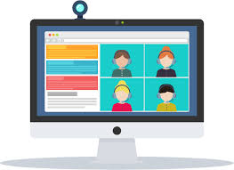
Real Time Chat App using Node.js
ChatGram
Pratham Goyal UE185084

Slide 2
Table of Contents
What’s new
Future Scope
Target Audience
Tools Used
Future Scope
Conclusion

Slide 3
What’s new
The Real Time Chat App has been made using Node.js and Socket.io.
Socket.IO is a JavaScript library for realtime web applications. It enables real time, bi-directional communication between web clients and servers and has two parts – a client-side library that runs in the browser, and a server-side library for Node.js.
Node.js is an open-source, cross-platform, back-end JavaScript runtime environment that runs on the V8 engine and executes JavaScript code outside a web browser.

Slide 4
Target Audience
Anyone having internet
Piracy Concerned people
Cross Platform Device
Chatting with friends
People with low disk space

Slide 5



Tools used
HTML
CSS
JS
NODE JS
socket.io

Slide 6
Future Scope
We will build a mobile app as well, as it is easy to use and not everyone can afford a PC.
Integrating with database for saving messages.
Maintain user sessions.
Support Multimedia in a message.
Further enhance the chat app.

Slide 7
Conclusion
Real time chat app can be accessed from any browser and does not need any app to be installed. This makes this app highly cross platform. It is very easy to use and user friendly. Source code for our app is available to everyone so privacy concerned people will have no issue using it. So we are assured that the audience for our app will only increase in the future.

Slide 8
THANK YOU

